Slide 1

HE5091
Principles of Economics
Lecture 3
Perfect Competition, Production and Efficiency
Tan Khay Boon
Email: khayboon@ntu.edu.sg

Slide 2
Topics
Perfectly Competitive Markets
Production and Cost
Profit and Loss in the Short Run
Market Equilibrium and Efficiency
Long Run Adjustment in Perfect Competition
Price control, subsidy and Efficiency
Reference: FBAH or FBL, chapters 6 & 7

Slide 3

Profit Maximization
Goods and services are produced by different organizations with different motives:
  Profit maximizing firms
  Nonprofit organizations
  Governments
Most goods and services are sold by profit maximizing firms
Economists assume the goal of the firm is to maximize profit
Profit is total revenue minus total cost
  Total cost includes explicit and implicit costs

Slide 4
Perfectly Competitive Firms
Perfectly Competitive Firms
Standardized Products
Many Buyers, Many Sellers
Mobile Resources
Informed Buyers and Sellers
Each has small market share
Identical goods offered by many sellers
No loyalty to
your supplier
No buyer or seller can influence price
Inputs move to their highest value use
Firms enter and leave industries
Buyers know market prices
Sellers know all opportunities and technologies
Price takers

Slide 5
Perfectly Competitive Firm’s Demand
Market supply and market demand set the price
  Buyers and sellers take price (P) as given
Perfectly competitive firm can sell all it wants at the market price
  Since the firm is small, its output decision will not change market price
  Each firm must decide how much to supply (Q)
Imperfectly competitive firms have some control over price
  Example is monopoly where there is only one producer in the market with large control over price

Slide 6
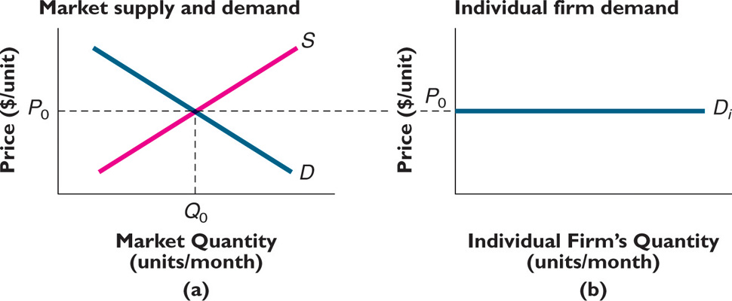
Perfectly Competitive Firm's Demand

Slide 7
Production Ideas
Production converts inputs into outputs
  Many different ways to produce the same product
  Technology is a recipe for production
A factor of production is an input used in the production of a good or a service
  Examples are land, labor, capital, and entrepreneurship
The short run is the period of time when at least one of the firm's factors of production is fixed
The long run is the period of time in which all inputs are variable

Slide 8
Production Data
Number of employees per day | Total number of bottles per day
0 | 0
1 | 80
2 | 200
3 | 260
4 | 300
5 | 330
6 | 350
7 | 362

Slide 9
Production in the Short Run
A perfectly competitive firm has to decide how much to produce
  Start by evaluating the short run
The firm produces a single product (glass bottles) using two inputs (workers and a bottle-making machine)
  Labor is a variable factor – it can be changed in the short run
  Bottle-making machine (capital) is a fixed factor – it cannot be changed in the short run
Determine the profit maximizing level of output

Slide 10
Law of Diminishing Returns
When some factors of production are
fixed, the marginal product of the variable factor will eventually decline

Slide 11
Law of Diminishing Returns
At low levels of production, the law of diminishing returns may not hold
  Gains from specialization
  Similar to the increase in a buyer’s marginal utility from a second unit
Diminishing returns eventually sets in and is often caused by congestion
    Only so many people can fit into the office
    Only one worker can use the machine at a time

Slide 12
Cost Concepts
Fixed cost (FC) is the sum of all payments for fixed inputs
  The $40 per day for the bottle machine
  Often referred to as the capital cost
Variable cost (VC) is the sum of all payments for variable inputs
  The total labor cost
Total cost (TC) is the sum of all payments for all inputs
  Fixed cost plus variable cost
Marginal cost (MC) is the change in total cost divided by the change in output

Slide 13
Find the Output Level that Maximizes Profit
Profit = total revenue – total cost
Total revenue comes from selling the bottles
Total cost = labor (variable) cost + capital (fixed) cost
The firm must know about both revenues and costs in order to maximize profits
  Increase output if marginal benefit is greater than the marginal cost
  Decrease output if marginal benefit is smaller than marginal cost

Slide 14
Maximizing Profit
Workers per day
0
1
2
3
4
5
6
7
Bottles per day
0
80
200
260
300
330
350
362
Fixed Cost ($/day)
40
40
40
40
40
40
40
40
Variable Cost ($/day)
0
12
24
36
48
60
72
84
Total Cost ($/day)
40
52
64
76
88
100
112
124
Marginal Cost ($/bottle)
0.15
0.10
0.20
0.30
0.40
0.60
1.00

Slide 15
Fixed Cost and Profit Maximization
The profit maximizing quantity does not depend on fixed cost
A firm should increase output only if the extra benefit exceeds the extra cost (cost-benefit principle)
The extra benefit is the price
The extra cost is the marginal cost – the amount by which total cost increases when production rises
The competitive firm produces where price equals marginal cost
When diminishing returns apply, marginal cost rises as production increases

Slide 16
Shut-Down Decision
Firms can make losses in the short run
  Some firms continue to operate
  Some firms shut down
The Cost – Benefit Principle applies even to losses
  Continue to operate if your losses are less than if you shut down
  Shut down if your losses are less than if you continued operating
  If shut down, Q = 0, VC = 0, TR = 0
  Loss when shut down = FC
Notes:
16

Slide 17
Shut-Down Condition
If the firm shuts down in the short run, it loses all of its fixed costs
  So, fixed costs are the most a firm can lose
The firm should shut down if revenue is less than variable cost: P ^{x} Q < VC for all levels of Q
  The firm is losing money on every unit it makes
If the firm's revenue is larger than the total variable cost, the firm should continue to produce
  Each unit pays its variable costs and contributes to fixed costs, P x Q > VC
    Losses will be less than fixed costs
Notes:
17

Slide 18
AVC and ATC
Average values are the total value divided by total quantity
  Average variable cost (AVC) is
        AVC = VC / Q
  Average total cost (ATC) is
        ATC = TC / Q
Shut-down if P ^{x} Q < VC
Or P < VC / Q
Or P < AVC
Shut down if price is less than average variable cost
Notes:
18

Slide 19
Profitable Firms
A firm is profitable if its total revenue is greater than its total cost
        TR > TC OR
        P ^{x} Q > ATC ^{x} Q since ATC = TC / Q
  Another way to state this is to divide both sides of the inequality by Q to get
        P > ATC
    As long as the firm's price is greater than its average total costs, the firm is profitable
Notes:
19

Slide 20

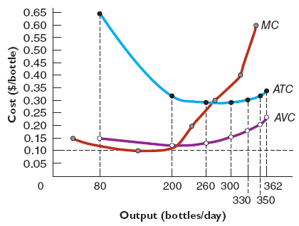
Cost Curves
Workers per day | Bottles per day | Variable Cost ($/day) | AVC ($ per unit) | Total Cost | ATC ($ per unit)
0 | 0 | 0 |  | 40
1 | 80 | 12 | 0.15 | 52 | 0.65
2 | 200 | 24 | 0.12 | 64 | 0.32
3 | 260 | 36 | 0.135 | 76 | 0.292
Marginal Cost ($/unit)
0.15
0.10
0.20
Notes:
20

Slide 21

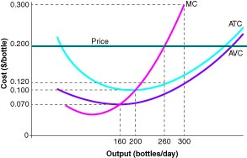
Graphical Profit Maximization
Market price is $0.20 per bottle
  Produce where the marginal benefit of selling a bottle (price) equals the marginal cost
    260 bottles per day
Notes:
21

Slide 22

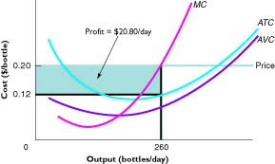
Graphical Profit Maximization
At a price of $0.20, the firm produces 260 bottles
Profit is TR – TC or
  (P – ATC) ^{x} Q
On the graph, (P – ATC) is
profit per unit of output
    It is the distance
    between P = $0.20 and
    the ATC curve
Profit is the area of the rectangle with height
(P – ATC) and width Q
    ($0.08) (260) = $20.80
Notes:
22

Slide 23

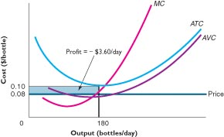
Losses
Losses can also be shown on a graph
    When P < ATC, the firm loses (P – ATC) per unit of output
  Total losses are the
  rectangle whose height
  is ATC – P and whose
  width is Q
  Losses = (ATC – P) (Q)
  ($0.10 – $0.08) (180)
  = $3.60
Notes:
23

Slide 24
Accounting Profit
Most common profit idea
  Accounting profit = total revenue – explicit costs
  Explicit costs are payments firms make to purchase
    Resources (labor, land, etc.) and
    Products from other firms

Slide 25
Economic Profit
Economic profit is the difference between a firm's total revenue and the sum of its explicit and implicit costs
  Also called excess profits
Implicit costs are the opportunity costs of the resources supplied by the firm's owners
Normal profit occurs when total revenue = Explicit cost plus Implicit cost
Normal profit = Zero economic profit
  The firm is earning the same amount as its opportunity (implicit) cost (the next best alternative use of its resources

Slide 26
Three Kinds of Profit
Total
Revenue
Total Revenue = Explicit Costs + Accounting Profit
Explicit
Costs
Explicit
Costs
Accounting
Profit
Economic
Profit = Accounting Profit – Implicit Cost
Implicit Cost
Economic
Profit

Slide 27
Example: Economic Profit Guides Decisions
Kim Hyun-woo's decision: continue farming or quit?
  Quit farming and earn $11,000 per year working retail
  Explicit farm costs are $10,000
  Total revenue is $22,000
  Kim should stick with farming
    His economic profit is positive
Accounting Profit | Economic Profit | Implicit Costs
$12,000 | $1,000 | $11,000

Slide 28
Example: Economic Profit Guides Decisions, A Change in Revenue
Kim Hyun-woo's decision: continue farming or quit?
  Quit farming and earn $11,000 per year working retail
  Explicit farm costs are $10,000
  Total revenue is $20,000
  Kim should quit
    His economic profit is negative
Accounting Profit | Economic Profit | Implicit Costs
$10,000 | -$1,000 | $11,000

Slide 29
Example: Owned Inputs
Rent for the farm land is $6,000 of the $10,000 in explicit costs
  What changes if Kim inherits the land?
    His rent payments become an implicit cost
Kim should quit farming
Total Revenue | Explicit Costs | Implicit Costs
$20,000 | $4,000 | $17,000
Accounting Profit | Economic Profit | Implicit Costs
$16,000 | -$1,000 | $17,000

Slide 30
The Invisible Hand (Price)
Individuals act in their own interests
  People maximizes their own self-interest
  This leads to maximum welfare for society
Profit motive
  Produces highly valued goods and services
  Allocates resources to their highest value use
  Allocate the product to consumers that pay the highest price
Allocate resources and output through price via the market system

Slide 31
Two Functions of Price
Rationing function of price distributes scarce goods to the consumers who value them most highly
Allocative function of price directs resources away from overcrowded markets to markets that are underserved
Invisible Hand Theory states that the actions of independent, self-interested buyers and sellers will often result in the most efficient allocation of resources
  Articulated by Adam Smith in eighteenth century

Slide 32
Responses to Profits and Losses
Will the firm remain in business in the long run?
  If it covers ALL of its costs
Firms that earn normal profit recover only their opportunity cost
Firms that earn positive economic profit recover more than their opportunity cost
Markets in which firms are earning economic profit will attract resources
Markets in which firms are suffering economic losses will lose resources

Slide 33

Response to Economic Profits
Markets with excess profits attract resources
Rice Industry
Typical Rice Farm
Price
$/bu
Price
$/bu
S
MC
ATC
Economic Profit
2
2
P
1.20
D
65
130
Quantity (M of bushels/year)
Quantity (000s of bushels/year)
Notes:
33

Slide 34

Shrinking Economic Profits
Supply increases
Rice Industry
Typical Rice Farm
Price
$/bu
Price
$/bu
S
MC
ATC
S'
Economic Profit
2
1.50
P
D
65
95
120
130
Quantity (M of bushels/year)
Quantity (000s of bushels/year)
Notes:
34

Slide 35

Market Equilibrium
Zero economic profits
Rice Industry
Typical Rice Farm
Price
$/bu
Price
$/bu
S
MC
ATC
S'
S"
2
1.50
1
D
P
65
115
90
130
Quantity (M of bushels/year)
Quantity (000s of bushels/year)
Notes:
35

Slide 36

Economic Losses
Resources leave
Price
$/bu
Rice Industry
Price
$/bu
Typical Rice Farm
MC
ATC
S
1.05
0.75
0.75
P
D
60
70
90
Quantity (M of bushels/year)
Quantity (000s of bushels/year)
Notes:
36

Slide 37

Market Equilibrium
No economic losses
Price
$/bu
Price
$/bu
MC
ATC
S'
S
1
P
0.75
D
40
60
70
90
Quantity (M of bushels/year)
Quantity (000s of bushels/year)
Notes:
37

Slide 38
Example: Movement Toward Equilibrium
Consider two perfectly competitive markets, haircuts and yoga with free entry and exit.
Assume both markets require similar resources and resources are mobile across the markets
Initially both markets are in long run equilibrium. All hairstylists and yoga instructors earn normal profit
Due to change in preferences
  Demand for haircuts decreases
  Demand for yoga class increases

Slide 39
Example: Movement Toward Equilibrium
Price of haircuts goes down; hair stylists have losses
Price of yoga classes go up; instructors have excess profits
Resources move out from haircuts market and flow into yoga market
Supply of haircut decreases, supply of yoga increases
Eventually the long-run prices of haircuts and yoga class return to long-run equilibrium
Notes:
39

Slide 40
Short-Run Adjustments
Haircut Market
Yoga Market
S
S
15
15
Price ($/haircut)
Price ($/class)
D'
12
10
D
D'
D
350
500
200
300
Haircuts/day
Classes/day
Notes:
40

Slide 41
Short-Run Adjustments
Typical Hair Salon
ATC_{H}
Typical Yoga Studio
ATC_{A}
MC_{H}
Economic
profit
MC_{A}
Economic
loss
15.50
15
Price ($/haircut)
Price ($/class)
12
11
Q_{A}
Q'_{H}
Q'_{A}
Q_{H}
Notes:
41

Slide 42
Cost-Saving Innovations
Competitive firms are price takers
Innovation lowers cost for one firm
  Profits increase by amount of cost savings and short run profit for innovative firm
  Information is freely available
In the long run, all firms use the same cost savings techniques, new firms enter the market
Market supply increases, equilibrium price decreases, profit decreases until zero profit in the long run

Slide 43
Market Equilibrium
Equilibrium leaves no opportunities for individuals to gain
  Non-equilibrium opportunities benefit individuals
    Exploiting opportunities moves the market toward equilibrium
No cash on the table
Markets work best when
  Buyers' marginal benefits = sellers' marginal costs
  AND
  Society's marginal benefits = society's marginal costs

Slide 44
Market Equilibrium and Efficiency
Economic efficiency exists when no change could be made to benefit one party without harming the other
  Equilibrium price and quantity are efficient
  Prices above or below equilibrium are not

Slide 45
Price Below Equilibrium
Suppose milk is $1 per liter
Only 2000 litres will be traded - Inefficient
S
2.50
2.00
1.50
Price ($/liter)
1.00
0.50
D
1
2
3
4
5
Quantity (1,000s of liters/day)

Slide 46
Price Below Equilibrium
A buyer offers $1.25 – Generate both consumer surplus ($0.75) and producer surplus ($0.25) – Welfare increases
S
2.50
2.00
1.50
Price ($/liter)
1.25
1.00
0.50
D
1
2
3
4
5
Quantity (1,000s of liters/day)

Slide 47
Price above Equilibrium
Suppose milk is $2 per liter
Only 2000 litres will be traded - Inefficient
S
2.50
2.00
1.75
1.50
Price ($/liter)
1.00
0.50
D
1
2
3
4
5
Quantity (1,000s of liters/day)
Only equilibrium price is efficient

Slide 48
Trade-Offs
Efficiency
Maximum Total Surplus
Equity
Fairness
Basic Needs

Slide 49
The Cost of Preventing Price Adjustments
Price ceilings
  A maximum allowable price, specified by law
Price subsidies
  Meant to assist low-income consumers, governmental funding of “essential” goods and services

Slide 50
Example: Heating Oil Market
2.00
S
1.80
1.60
Consumer surplus = $900/day
1.40
Producer surplus = $900/day
1.20
Price ($/liter)
1.00
.80
D
1
2
3
4
5
8
Quantity (1,000s of liters/day)

Slide 51
Price Ceiling on Heating Oil
2.00
Consumer surplus = $900/ day
1.80
S
1.60
1.40
Lost surplus = $800/ day
1.20
Price ($/liter)
1.00
0.80
Producer surplus = $100/ day
D
1
2
3
4
5
8
Quantity (1,000s of liters/day)

Slide 52
Surplus Lost to a Price Ceiling
$800 underestimates surplus loss
  Consumers place different values on heating oil
    If a person with a lower reservation price gets the oil, there is additional surplus lost
    Shortages increase non-market costs
      Waiting in line
      Side payments

Slide 53
Alternative Heating Oil Policy
Surplus with
Price Controls
Surplus with Income
Transfers Only
R
R
P
P
R = high income
P = low income

Slide 54
Example: Price Subsidy for Bread
Imported bread costs $2
  Perfectly elastic supply
Government program to subsidize bread
  Government imports bread for $2
  Government sells bread for $1
  Results
    More bread
    Less efficiency

Slide 55
Price Subsidies for Bread
Price
($/loaf)
$4.00
Original Consumer Surplus = $4 M/month
$3.00
$2.00
S
New Consumer Surplus = $9 M/month
$1.00
S with subsidy
D
2
4
6
8
Quantity (millions of loaves/month)
BUT…

Slide 56
The Cost of the Subsidy
The bread subsidy appears to increase consumer surplus from $4 million to $9 million, an increase of $5 million
BUT …
  The government loses $1 on every loaf
    Imports 6 million loaves for $2 per loaf
  Government losses are $6 million
The net benefit of the subsidy program
  Gain in Consumer surplus – government losses
  $5 million - $6 million = -$1 million

Slide 57
Price Subsidies for Bread
Price
($/loaf)
Consumer Surplus
$4.00
Total Surplus Lost
= $1 M/month
$3.00
$2.00
S
Government Losses
$1.00
S with subsidy
D
2
4
6
8
Quantity (millions of loaves/month)

Slide 58
Effects of Tax and Subsidy
Taxes lead to underproduction
Output stops where marginal benefit still exceeds marginal cost
Cash-on-the-Table and inefficiency
Subsidy leads to overproduction
Output level reflects marginal cost exceeds marginal benefit
Waste of resources and inefficiency

Slide 59
Underproduction (Tax)
Supply (MC)
Deadweight loss
MB > MC
Demand (MB)
Q
Quantity

Slide 60
Over Production (Subsidy)
Price
Supply (MC)
Deadweight loss
MC > MB
Demand (MB)
Q
Quantity

Slide 61
Thank You
This is the end of Lecture 3.
Thank you for your participation.
Please send your query to me via my email at khayboon@ntu.edu.sg.

